Slide 1

ByBy
AI-POWERED
REGULATORY COMPLIANCE CHECKER
for
Contracts
Group 2
By Rahul, Rithika & Rimi

Slide 2

1
Introduction
Contents
2
Problem Statement
3
Objectives
4
Architecture Diagram
5
Technology stack
6
Features
7
Future Improvements

Slide 3

Introduction
What is it?
A cutting-edge AI tool for analyzing legal contracts and ensuring regulatory compliance.
Why is it needed?
Contracts are often lengthy, complex, and time-consuming to review.
Compliance issues can lead to significant legal and financial risks.
How does it work?
Upload contracts and receive AI-driven insights, including clause extraction and compliance analysis.

Slide 4
Problem Statement
To address the challenges faced by legal professionals and businesses in contract review, including:
1
The time-consuming and costly nature of manual reviews.
2
The high risk of missing regulatory compliance
requirements.
3
The difficulty in identifying ambiguities, contradictions, and missing clauses in contracts.

Slide 5
Objectives
1
2
3
4
Automate clause extraction for faster document analysis.
Evaluate contracts for compliance with legal and business standards.
Provide actionable recommendations to improve contract quality.
Enhance efficiency and accuracy for legal professionals and businesses.

Slide 6

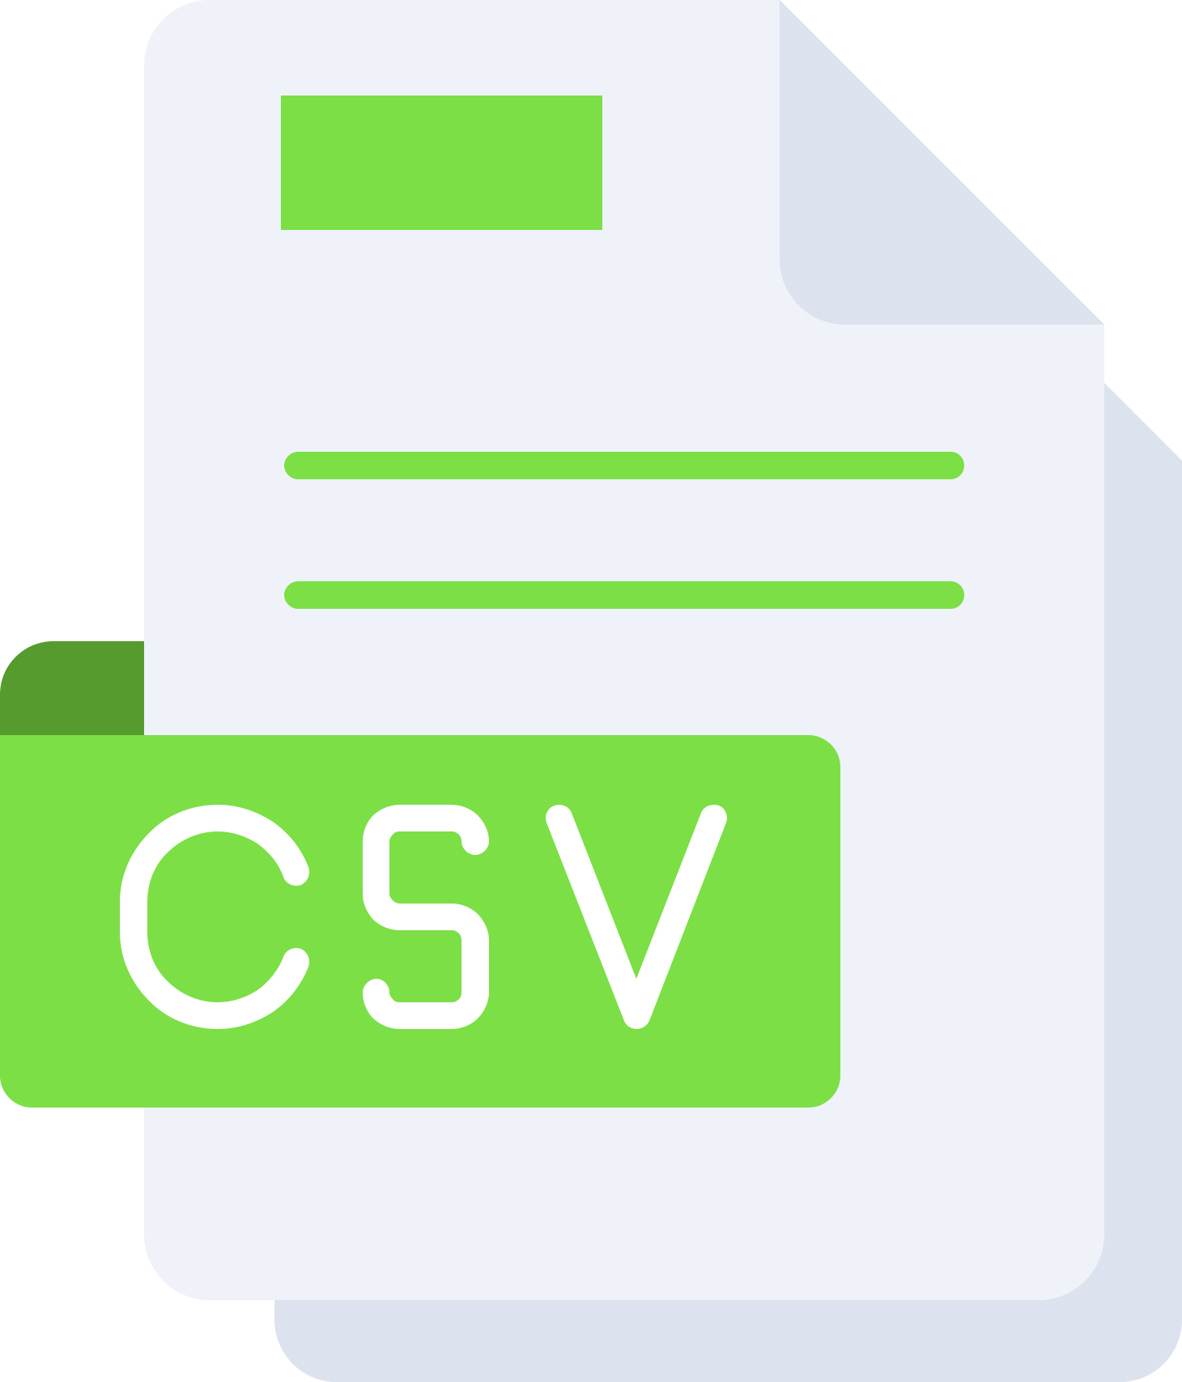









Architecture Diagram
Web Scraping
Dataset
Data
Preprocessing
User Uploads file
RAG
LLM
RAG Model
Preprocessed
Data
(To identify the Key clauses)
Output
(Detailed analyed Reports of the user Uploaded Contract)
Key Clauses
LLM
(Identify the associated risks in the contract.)

Slide 7




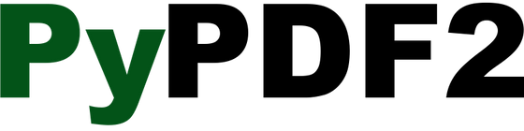


Technology Stack
Languages: Python.
Frameworks: Streamlit, PyTorch.
APIs: Groq OpenAI for contract analysis.
Libraries:
PyPDF2, Python-docx (text extraction).
Sentence Transformers (embeddings).
Scipy (similarity calculations).
Database: ChromDB for embedding storage.

Slide 8
Features
1
2
3
4
Key Clause Extraction
Detailed Analysis
File Support
User-Friendly Interface
Uses advanced LLMs to extract essential clauses from contracts.
AI evaluates contracts for compliance, clarity, and completeness.
Upload contracts in PDF, DOCX, or TXT formats.
Intuitive Streamlit dashboard for interaction.

Slide 9
Future Improvements
Enhanced AI Models
Multilingual Support
Integration with Legal Tools:
Advanced Visualizations
Incorporate fine-tuned legal models for better accuracy.
Analyze contracts in multiple languages.
Seamless integration with popular legal software.
Include graphs and charts for better analysis insights.
Real-Time Updates
Continuous updates for compliance with changing regulations.

Slide 10


THANK YOU!

